Slide 1

Team Name : Synthetix
Team Leader Name : Sarthak Deodhar
Problem Statement : Documentation Debt: Technical debt consumes 30% of senior developer capacity, costing teams significantly in lost productivity.
Linguistic Exclusion: English-only documentation creates barriers for Bharat's 5.5 million+ developers, particularly in Tier-2/3 cities.

Slide 2

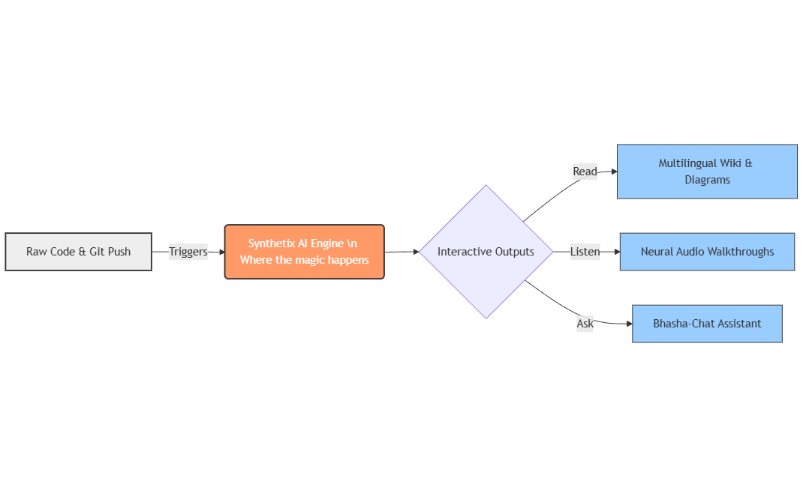
Synthetix Docs: AI-Augmented Technical Navigator for Bharat
Concept: An intelligent, serverless platform designed to transform static technical documentation into an interactive, multilingual learning assistant for the Indian developer ecosystem.
Core Innovation: Unlike traditional wikis, the system is event-driven—it automatically regenerates documentation, architecture diagrams, and audio walkthroughs instantly whenever code is pushed to GitHub.
Impact: It bridges the linguistic gap by enabling developers to query technical concepts in 20+ Indic languages and receive context-aware, localized explanations via text or neural audio.

Slide 3
How different is it from any of the other existing ideas?
Unlike traditional static documentation that becomes obsolete quickly, our system is event-driven and self-updating. While standard wikis rely on manual edits, Synthetix Docs automatically regenerates technical guides, architecture diagrams, and security advisories immediately upon every Git push, ensuring 100% freshness.
How will it be able to solve the problem?
It solves "Linguistic Exclusion" by enabling developers to query codebases in 20+ Indian languages via the Bhasha-Chat RAG widget, breaking the English barrier.
It solves "Onboarding Inefficiency" by using Skill-Adaptive Content that personalizes documentation depth, reducing new hire ramp-up time from 3–4 weeks to just 3–5 days (80% reduction).
USP of the proposed solution
The Bharat Explainer: The first tool to generate 60-second neural audio walkthroughs of complex code logic in 10+ Indic languages (Hindi, Marathi, Tamil, etc.) for deeper comprehension.
Suraksha-Audit: An integrated scanner that doesn't just document code but proactively identifies vulnerabilities and writes Security Advisories automatically.

Slide 4
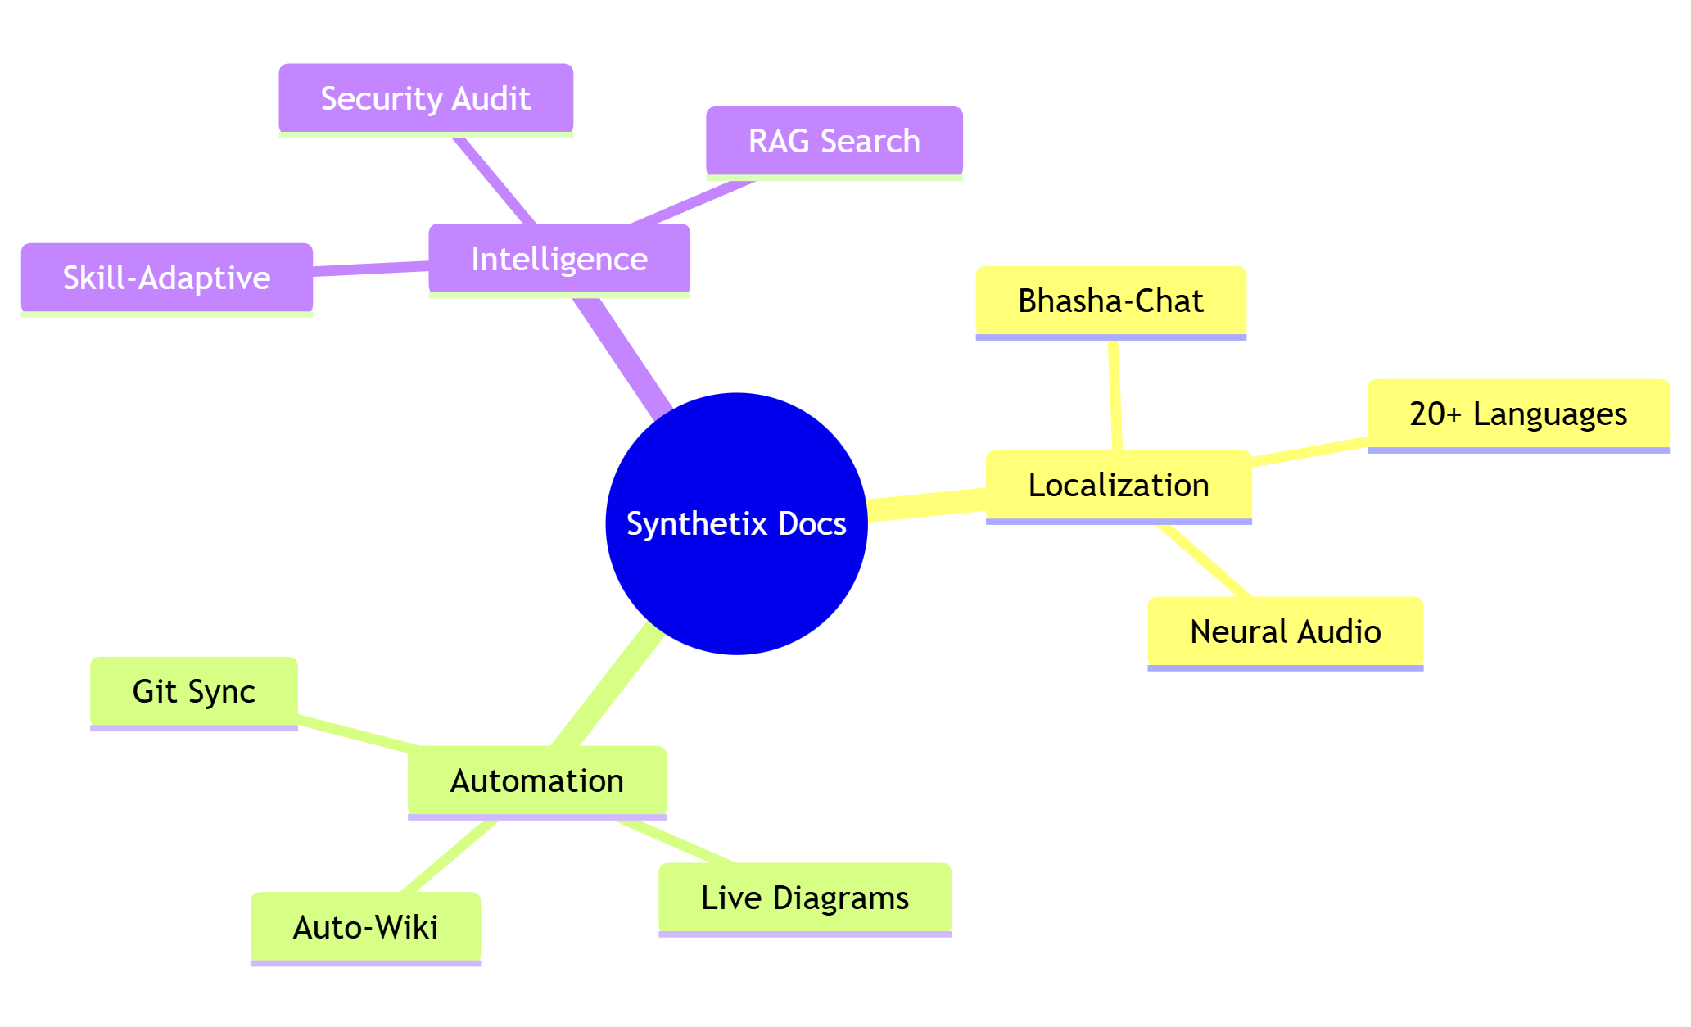
Multilingual Semantic Search: Query technical documentation in 20+ Indian languages with >90% accuracy using Amazon Bedrock.
Autonomous Wiki & Mapper: Automatically regenerates the entire documentation portal and live Mermaid.js architecture diagrams within 5 minutes of a Git push.
The Bharat Explainer: Generates 60-second neural audio walkthroughs of code logic in 10+ Indic languages (Hindi, Marathi, Tamil, etc.).
Bhasha-Chat Widget: An embeddable RAG-based chat widget that allows developers to ask "What does this code do?" in their native language.
Suraksha-Audit: A security scanner that detects vulnerabilities (OWASP Top 10, secrets) and automatically writes Security Advisories.
Skill-Adaptive Content: A dynamic toggle that switches documentation depth between "Junior" (step-by-step) and "Senior" (architecture patterns) views.

Slide 5
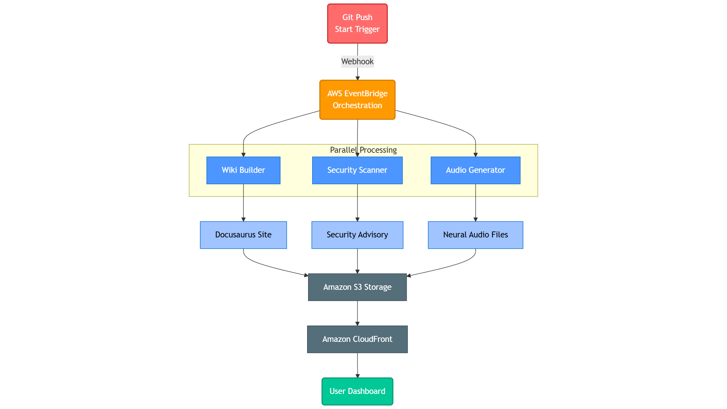
Trigger: The process initiates instantly via a GitHub Webhook whenever code is pushed.
Orchestration: AWS EventBridge receives the event and triggers three parallel Lambda functions.
Parallel Processing:
Wiki Builder: Generates documentation and live architecture diagrams.
Security Scanner: Runs CodeGuru scans and identifies vulnerabilities.
Audio Generator: Synthesizes neural audio walkthroughs using Amazon Polly.
Delivery: All artifacts are stored in Amazon S3 and delivered globally via CloudFront to the user dashboard.

Slide 6
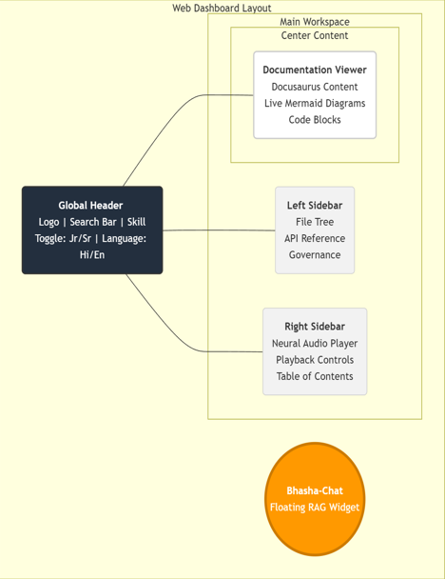
Wireframes/Mock diagrams of the proposed solution:
Unified Dashboard: A single-page React application containing the Wiki, Interactive Diagrams, and Audio Player in one view.
Smart Header: Contains the "Skill Level Toggle" (Junior/Senior) and Language Selector for instant personalization.
Bhasha-Chat Widget: A collapsible, floating widget in the bottom-right corner for real-time, localized Q&A without leaving the documentation.
Audio Sidebar: Dedicated controls for playback speed (0.75x - 1.5x) and language selection for the neural audio walkthroughs.

Slide 7
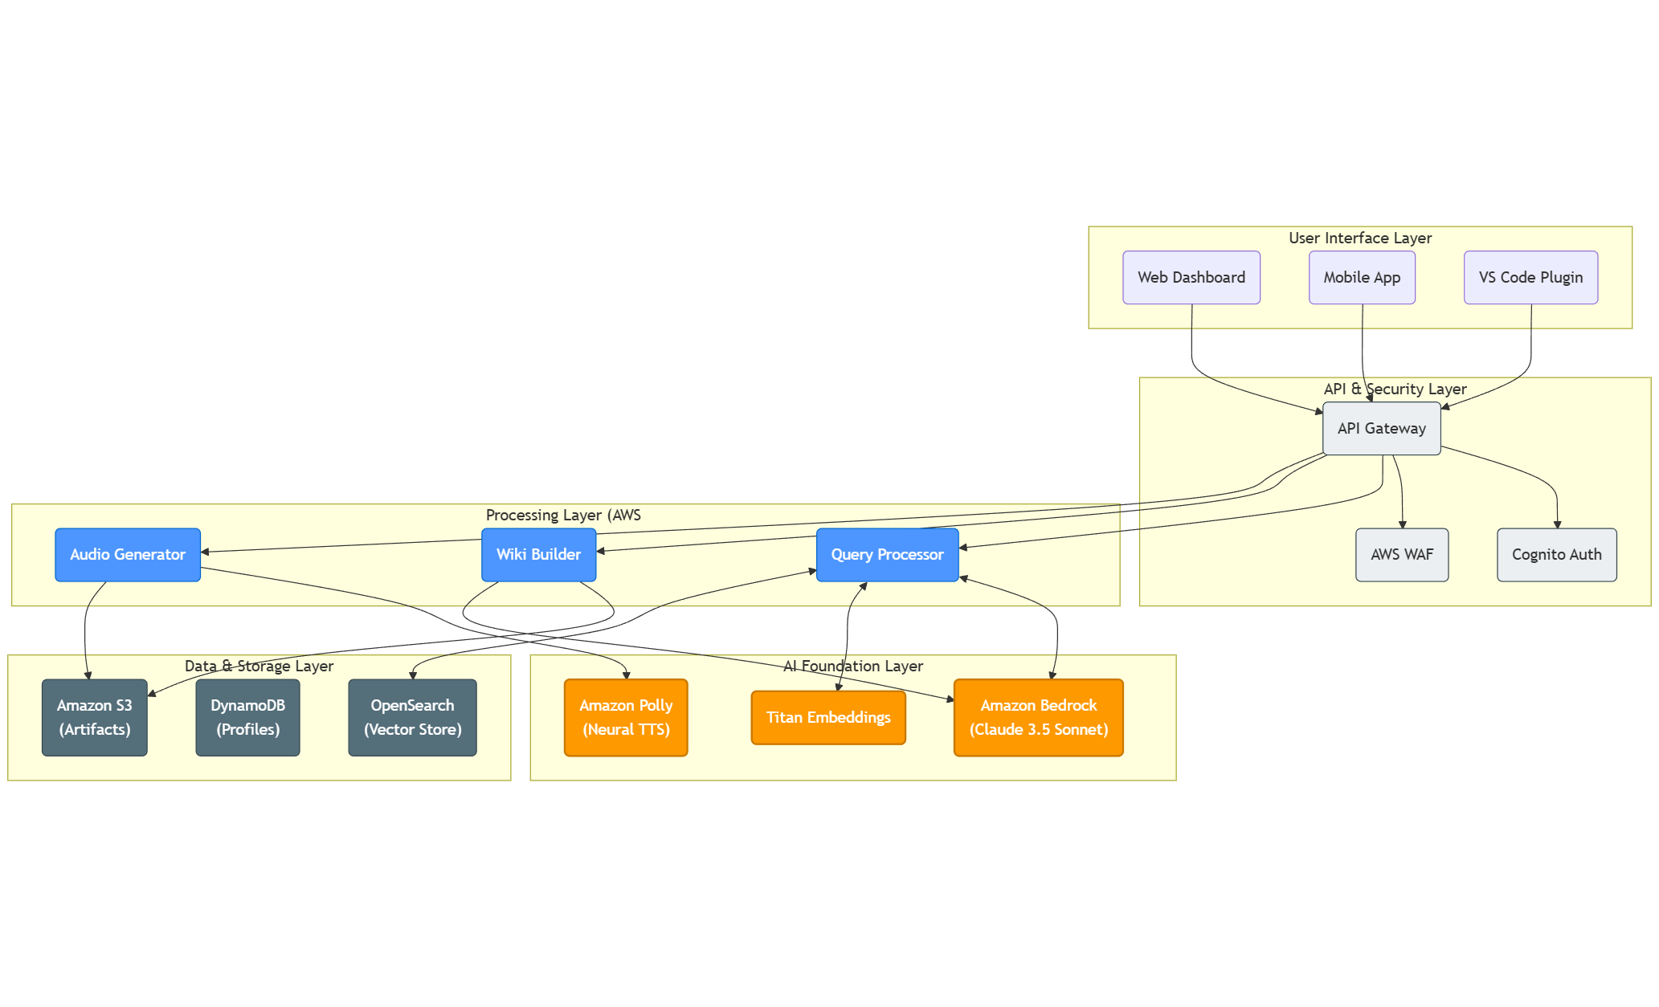
Architecture diagram of the proposed solution:
Serverless & Event-Driven: Built entirely on AWS Lambda and EventBridge, ensuring zero idle costs and infinite scalability for burst traffic.
Multi-Agent AI Layer: Leverages Amazon Bedrock (Claude 3.5 Sonnet) for reasoning, Amazon Polly for neural audio synthesis, and Titan Embeddings for vector search.
High-Performance Data Layer: Uses OpenSearch Serverless for millisecond-latency vector retrieval (RAG) and DynamoDB for storing user profiles and learning paths.

Slide 8
Technologies to be used in the solution:
Generative AI & ML:
Amazon Bedrock: Claude 3.5 Sonnet (Reasoning) & Titan Embeddings (Vector Search).
Amazon Polly: Neural Text-to-Speech for localized audio.
Amazon Translate: Real-time multilingual translation.
Serverless Compute & Integration:
AWS Lambda: Serverless function execution.
Amazon EventBridge: Event-driven orchestration.
Data & Storage:
Amazon OpenSearch Serverless: High-performance vector database for RAG.
Amazon DynamoDB: User profiles and learning paths.
Amazon S3: Object storage for documentation artifacts and audio files.
Security & Frontend:
Amazon CodeGuru Security: Automated vulnerability scanning.
React.js & Docusaurus: Frontend UI and static site generation.

Slide 9
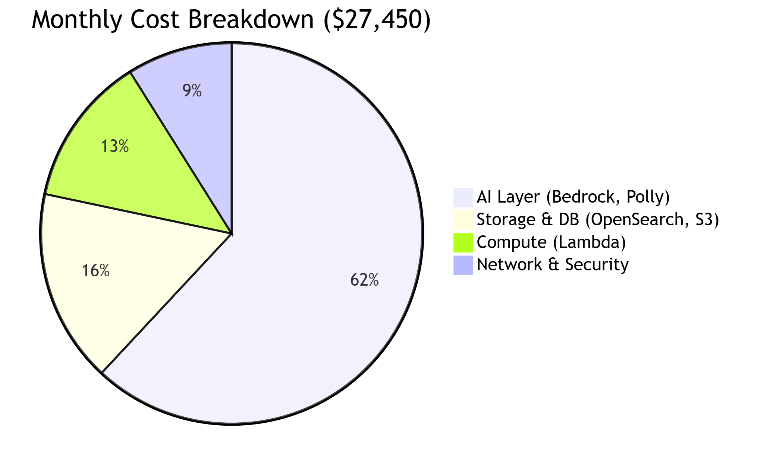
Estimated implementation cost (optional):
AI Services (~62%): $17,000 – Primarily Amazon Bedrock (Claude 3.5 Sonnet) and Polly for high-quality reasoning and neural audio.
Data & Storage (~16%): $4,500 – OpenSearch Serverless for vector RAG and DynamoDB for user profiles.
Compute (~13%): $3,500 – AWS Lambda functions for event-driven processing.
Optimization Strategy: Projected to reduce costs by 32% (to ~$18,750/month) within 6 months by implementing aggressive caching and AWS Savings Plans.

Slide 10
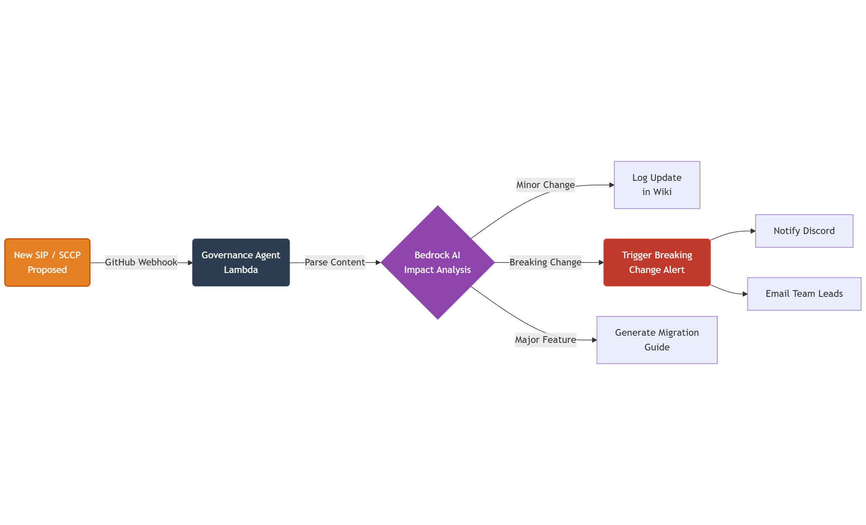
Carbon-Aware Architecture: Integrates with the AWS Customer Carbon Footprint Tool to track real-time emissions and optimize regional workload distribution (e.g., routing traffic to regions with higher renewable energy availability).
Eco-Friendly Compute: Utilizes ARM-based AWS Graviton processors (20% more efficient) and schedules heavy batch jobs (like audio generation) during off-peak, low-carbon intensity hours.
Sustainability Goals: Targeting < 1.5 kg CO2e per user/month and achieving 40% renewable energy usage in the first year of operation.

Slide 11


